Slide 1
Operation Analytics and Investigating Metric Spike

Slide 2
Project description
In this project , we will perform operation analysis on the provided table record.
Operation Analytics is the analysis done for the complete end to end operations of a company.
With the help of this, the company then finds the areas on which it must improve upon.
This kind of analysis is further used to predict the overall growth or decline of a company.
Investigating metric spike is also an important part of operation analytics.
With the help of this analysis, data analyst is able to understand and answer to various question related to progress of company.

Slide 3
Operation analytics
Operational analytics is a category of business analytics that enables continuous monitoring of data and discovery of insights to help teams make better decisions on the fly.
In simple words, it processes real-time signals from various parts of a business to offer instant feedback. It lets you sync information directly from your data warehouse into front-end tools—Salesforce, Marketo, HubSpot, etc.— that your team uses every day.
This allows teams to accurately track data across various platforms and tools, streamline everyday business operations, improve efficiency, and enhance cross-functional team collaboration.

Slide 4
Approach
Get the information from given description about data and understood the problem.
Go through the row data and understand the variable and attribute as given.
Used MySQL Workbench I import files in new database Ops spike and I started writing my queries as question asked to achieve the result.
Executed the Queries and if there are any errors in the code, I modified the code and fixed the code without any errors.
Once done all queries I cross checked all the quires and save in the file.
Finally, I attached my code to the file.

Slide 5




Tech - Used

Slide 6

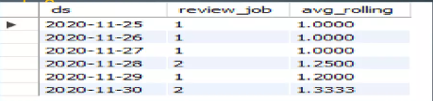
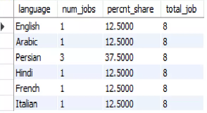
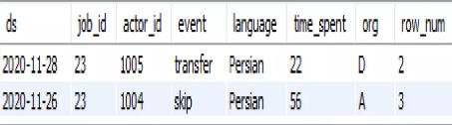
Insights and results
Calculate the number of jobs reviewed per hour per day for November 2020?
Calculate 7 day rolling average of throughput? For throughput, do you prefer daily metric or 7-day rolling and why?
Calculate the percentage share of each language in the last 30 days?
Duplicates Entries from the table

Slide 7

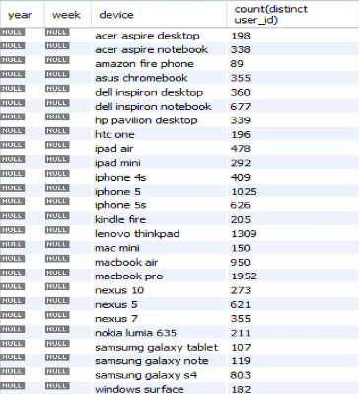
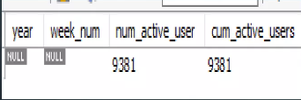

Case Study 2 (Investigating metric spike)
Calculate the weekly user engagement?
Calculate the weekly retention of users-sign up cohort?
Calculate the email engagement metrics?
Calculate the weekly engagement per device?

Slide 8
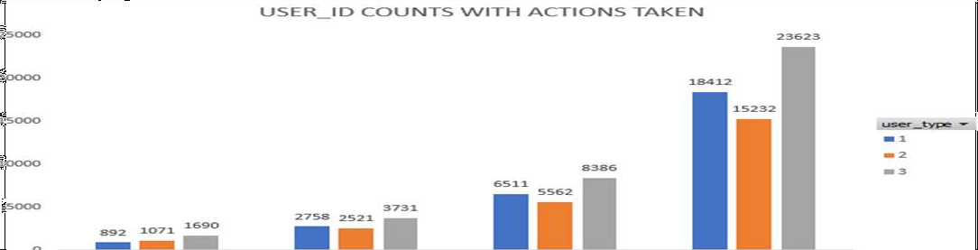
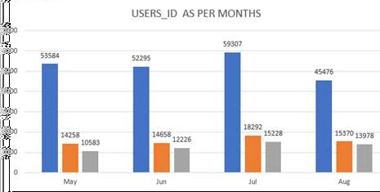
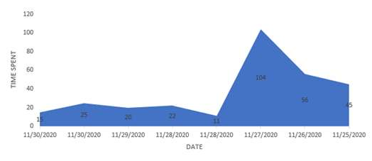

Slide 9
Thank you
By : Rohit Bahuguna
You can find me at rohitbahuguna14@gmail.com

